Slide 1
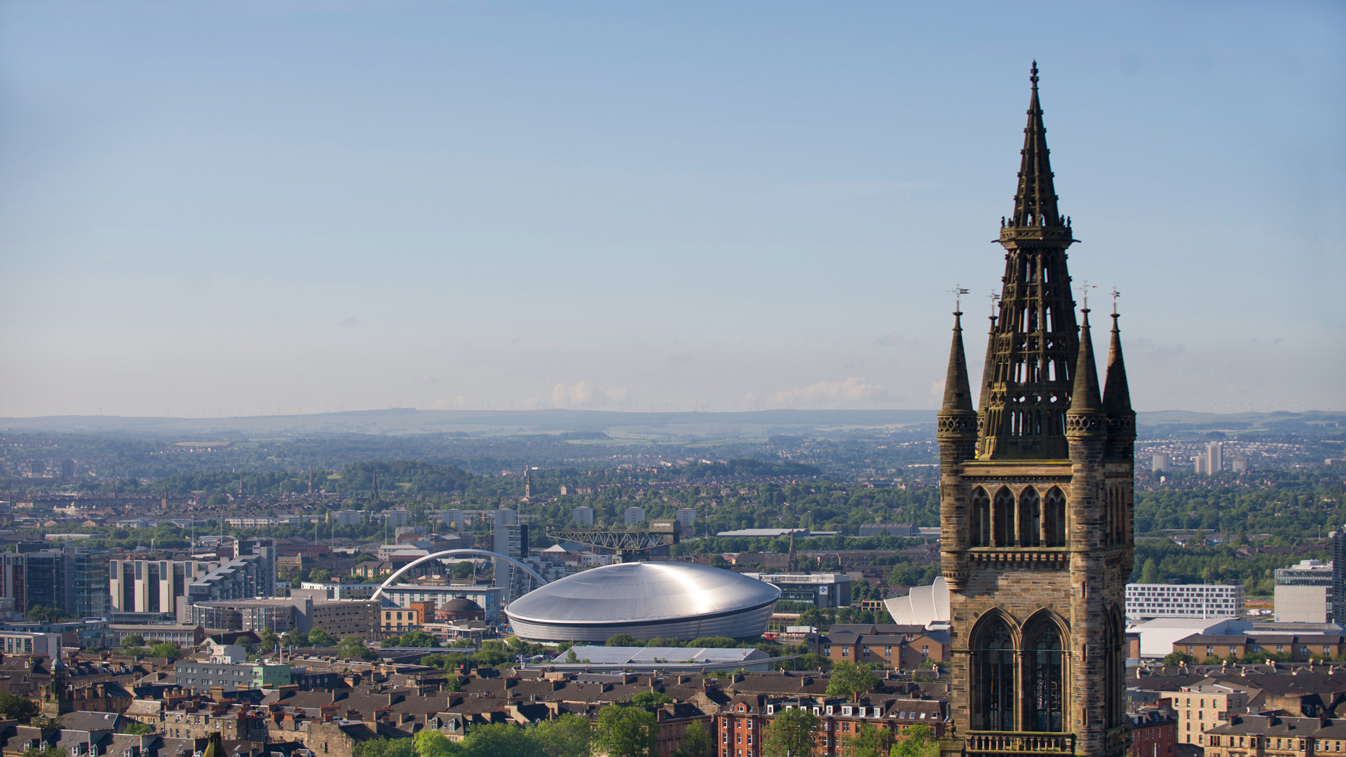

Financial Literacy and Attitudes to Cryptocurrencies
3rd Crypto Asset Lab Conference
4th November 2021
Georgios Panos
Adam Smith Business School - University of Glasgow
Joint work with Tatja Karkkainen and Adele Atkinson

Slide 2
A new economic landscape for personal financial well-being
Changes in the financial markets and the financial technology
Capabilities: Liquidity, financial inclusion, more opportunities
Challenges: Increased complexity, financial illiteracy, digital illiteracy
Changes in the pension landscape
More choice and more individual accounts
Ageing, increasing life expectancy, and low interest rates
Changes in the labour markets
4th / 5th industrial revolution
Increased international mobility
Changes in the political sphere
Tighter government budgets (Austerity, crisis, distrust)
Political choices (Referendums, devolution, public finance)
Covid-19 and post-Covid-19 era
Capabilities: Expansionary fiscal policy, Teleworking, E-commerce, Online education
Challenges: Financial stress, financial resilience, job reallocation, debt

Slide 3
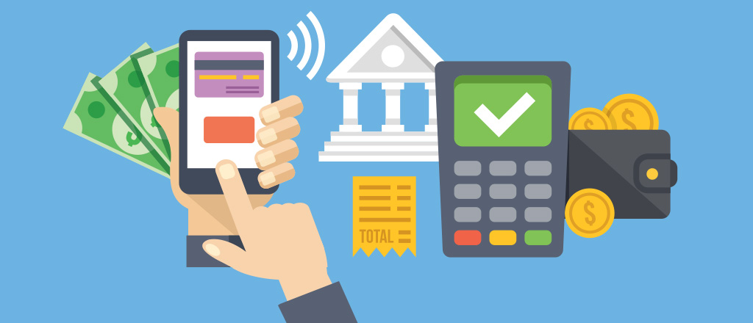
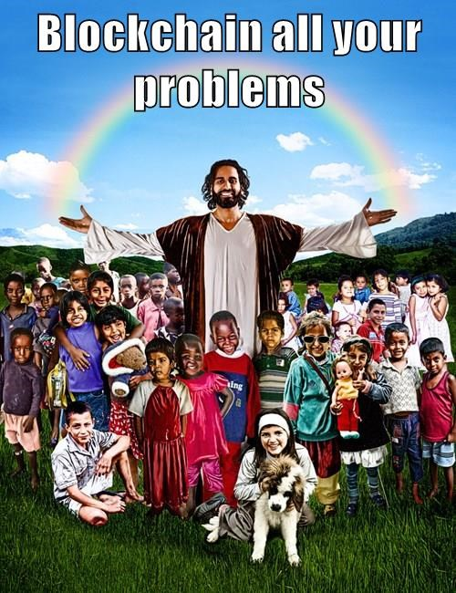

The Fintech Era

Slide 4
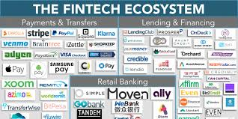
What triggered the fintech revolution?
Some ideas have been kicking around for a while
A turning point for the financial world was the emergence in 2009 of bitcoin, a digital or crypto- currency
Bitcoin relied on both cryptography and blockchain
Together with other technologies, they enable transactions to occur on a peer-to-peer level, without third-party verification
Also, since 2010, investment in fintech has shot up from$2 billion to $19 billion, accelerating transformation

Slide 5
Motivation
There are approximately 5,392 cryptocurrencies being traded with a total market capitalization around $400bn
July 2018: Over 1,800 cryptocurrencies with market capitalization >$300 billion
Bitcoin, the largest cryptocurrency, accounts for around half of the total market capitalization.
The numerous online cryptocurrency exchanges and markets have had daily dollar volumes of around $50 billion.
Over 300 “cryptofunds” have emerged (hedge funds that invest solely in cryptocurrencies), attracting around $10 billion in assets under management (Rooney and Levy, 2018).
At least 150 active cryptofunds (PwC, 2020)
As of 2018, Bitcoin futures have commenced trading on the CME and CBOE, catering to institutional demand for trading and hedging bitcoin.

Slide 6
Volatility I

Slide 7
Volatility II

Slide 8
Concerns
Central bank heads, such as the Bank of England’s Mark Carney, have publicly expressed concerns about cryptocurrencies.
While cryptocurrencies have many potential benefits including faster and more efficient settlement of payments, regulatory concerns revolve around their use in illegal trade (drugs, hacks and thefts, illegal pornography, and, even, murder-for-hire), potential to fund terrorism, launder money, and avoid capital controls.
There is little doubt that by providing a digital and anonymous payment mechanism, cryptocurrencies, such as bitcoin, have facilitated the growth of online “darknet” marketplaces in which illegal goods and services are traded.
In a recent study (Foley, et al., 2019, RFS) estimate that around $76 billion of illegal activity per year involves bitcoin (46% of bitcoin transactions), which is close to the scale of the U.S. and European markets for illegal drugs.

Slide 9
Who buys cryptocurrencies?
We examine the demand attitudes to cryptocurrencies using microdata from 15 countries of the ING Global Banking Survey
We generate a financial literacy proxy using data from the S&P 2015 Global Financial-Literacy Survey, and construct a composite index based on country scores overall and by gender, age and income group
We examine the relationship between financial literacy and attitudes to cryptocurrencies, in terms of owning, intending to own, not intending to own, and not having heard of them (4 categories)
We establish the external validity of our financial literacy proxy and findings, using a custom survey with the OECD in 3 Asian countries, namely the OECD Consumer Insights Survey on Cryptoassets

Slide 10
Who buys cryptocurrencies?
We attempt to identify the moderating mechanisms in the relationship between financial literacy and attitudes to cryptocurrencies
Technological literacy
Age
Financial advice
Perceptions of risk and reward

Slide 11
Why should financial literacy matter?
Informed financial decisions critical to sound personal finance (Bernheim, 1995, Lusardi & Mitchell, 2014; 2007a; 2007b; and 2008a; 2011; Lusardi & Tufano, 2008; Lusardi, 2009; Cole & Shastry, 2008) and the more efficient allocation of financial resources
Greater financial stability, less fragility (e.g. loan losses)
Retirement planning decisions (e.g. Lusardi and Mitchell, 2011, Klapper and Panos, 2011)
Stock market participation (van Rooij, et al., 2011) and the frequency of stock trading (Graham, et al., 2009)
Financial inclusion and demand for formal banking services (Cole, et al., 2008; Klapper, Lusardi and Panos, 2013)
Increased saving rates, returns to long-term saving (Stango & Zinman, 2008) & lending to poorest & vulnerable (Cole & Zia, 2010)
Choosing a low-fee investment portfolio (Choi, et al., 2010; Duarte and Hastings, 2012)
Portfolio diversification (von Gaudecker, 2015)
Glaser, et al. (2014): ‘we find strong indications that especially uninformed users approaching digital currencies are not primarily interested in an alternative transaction system but seek to participate in an alternative investment vehicle’.

Slide 12
Research question
Should we expect the financially-literate to be in favour or against cryptocurrencies, such as the Bitcoin?
If the more financially literate are more likely to invest (van Rooij, et al., 2011, JFE) have a more diversified asset portfolio and obtain higher asset returns (von Gaudecker, 2015, JF; Bianchi, 2018, JF), the answer should be yes.
If the more financially literate have access to better financial information, advisors (Calcagno and Monticone, 2015; Stolper, 2018) and more informed networks/peers (Chaliasos, et al., 2017, RFS), then the answer could be either yes or no
If the more financially literate are better positioned to evaluate risk, control sentiment (Baker and Wurgler, 2007, JEP) and urges, then the answer should be no
Perceptions drive decision-making among low-literacy respondents and are associated with mistaken beliefs about financial products and less willingness to accept financial advice (Anderson, et al., 2017, JFE)

Slide 13
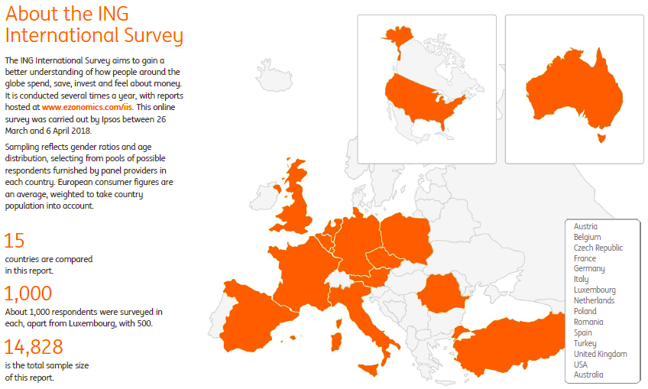
Data I: ING Mobile Banking Survey

Slide 14
Who likes cryptocurrencies?

Slide 15
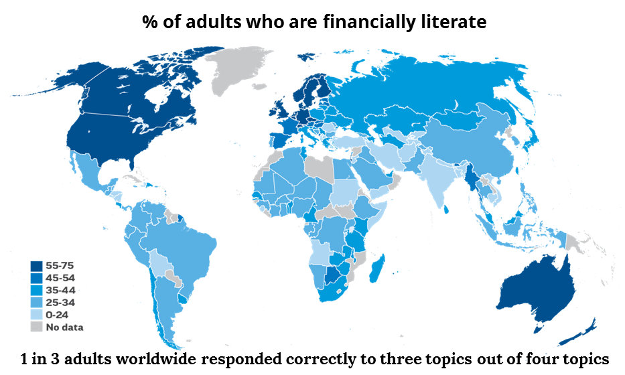
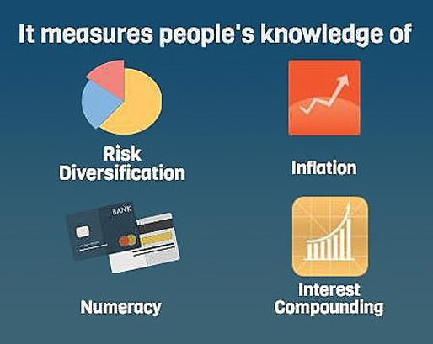
Financial Literacy: S&P 2014 data
With data on financial literacy from a survey of more than 150,000 people in 140 economies worldwide, the 2014 Standard & Poor’s Ratings Services Global Financial Literacy Survey (S&P Global FinLit Survey) represents the most comprehensive global measure of financial literacy to date.

Slide 16
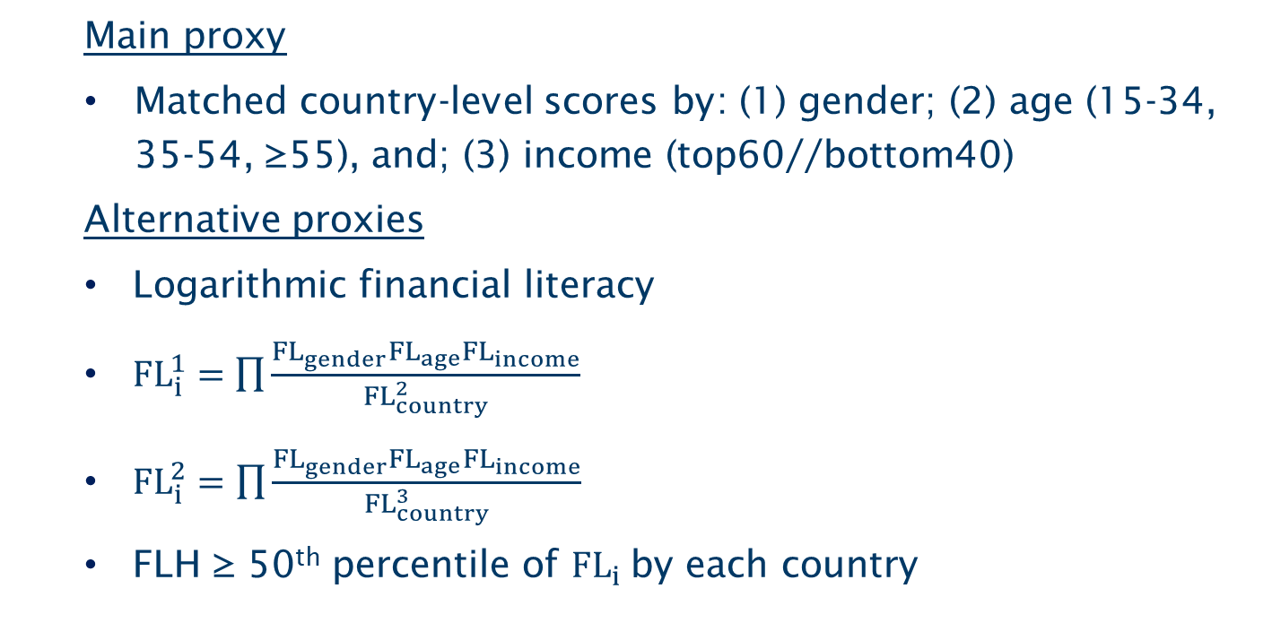
Financial literacy proxies
Main proxy
Matched country-level scores by: (1) gender; (2) age (15-34, 35-54, ≥55), and; (3) income (top60//bottom40)
Alternative proxies
Logarithmic financial literacy
${FL}_{i}^{1}=\prod{\frac{{FL}_{gender}{FL}_{age}{FL}_{income}}{{FL}_{country}^{2}}}$
${FL}_{i}^{2}=\prod{\frac{{FL}_{gender}{FL}_{age}{FL}_{income}}{{FL}_{country}^{3}}}$
FLH ≥ 50th percentile of ${FL}_{i}$by each country

Slide 17
Financial literacy and attitudes to cryptocurrencies

Slide 18
Data II: OECD 2019 Consumer Insights Survey on Cryptoassets
We examine the external validity of our findings, using data from the OECD 2019 Consumer Insights Survey on Cryptoassets (OECD, 2019).
This is based on a custom questionnaire, designed to survey consumers/retail investors to collect data on their attitudes, behaviours and experiences towards digital financial assets, specifically digital (or crypto) currencies and initial coin offerings.
Importantly, in included questions on the financial literacy of investors.
The financial literacy variable is calculated as the number of correct response in the following two questions: “An investment with a high return is likely to be high risk”, and “High inflation means that the cost of living is increasing rapidly”. The response categories involved “True”, “False”, and “I don’t know”.
The survey of some 3,428 retail investors in Malaysia, the Philippines, and Vietnam is a selected sample entailing familiarity with cryptocurrencies.
36.8% of the investors currently own some cryptocurrency, 14.6% previously owned, 31.1% never held any cryptocurrency, and 17.5% have never heard of cryptocurrencies.

Slide 19
Empirical strategy
Dependent variable: Attitudes to cryptocurrencies (ING 2018 survey)
Multinomial probit – 4 outcome categories (Own; Expect to own; Do not expect to own; Not having heard)
Weighted estimation, with country-level representative weights
Financial literacy proxy (S&P 2014 survey)
Matched country-level scores by: (1) gender; (2) age (15-34, 35-54, ≥55), and; (3) income (top60//bottom40)
The unit is the number of people who responded correctly to at least 3/4 questions
Our main measure is the average figure by gender, age group, and income group, by country (180 profiles)
Controls: Gender, age, marital & family status, education, labour-market status, real (PPP-deflated ) equivalized household income per capita (3rd order polynomial), 15 country dummies

Slide 20
Financial literacy and attitudes to cryptocurrencies

Slide 21
Robustness I: Country Interactions

Slide 22
Robustness IV: Endogeneity – Omitted variable bias

Slide 23
Robustness V: External validity – Financial literacy – OECD survey

Slide 24
Robustness V: External validity – OECD survey – IV

Slide 25
 | Own | Intend to own | Not intend to own |  | Own | Intend to own | Not intend to own
 | (A₁) | (A₂) | (A₃) | (B₁) |  | (B₂) |  | (B₃)
Financial literacy | -0.489*** | 0.133 | 0.356* | -0.202 |  | 0.011 |  | 0.191
 | [0.162] | [0.183] | [0.184] | [0.232] |  | [0.252] |  | [0.269]
Digital currencies – e.g. Bitcoin – are the future of | 0.036*** | 0.053*** | -0.089*** | 0.048*** |  | 0.019 |  | -0.067***
spending online | [0.005] | [0.006] | [0.006] | [0.018] |  | [0.021] |  | [0.022]
‒”‒ are the future of investment as storage of value | 0.023*** | 0.053*** | -0.076*** | 0.052*** |  | 0.061*** |  | -0.113***
 | [0.006] | [0.007] | [0.006] | [0.019] |  | [0.022] |  | [0.022]
I think the value of digital currencies – e.g. Bitcoin | 0.038*** | 0.014*** | -0.052*** | 0.013 |  | 0.021 |  | -0.034*
– will increase in the next 12 months | [0.005] | [0.005] | [0.005] | [0.016] |  | [0.018] |  | [0.019]
Fin. literacy*Future of spending online | ‒ | ‒ | ‒ | -0.026 |  | 0.069* |  | -0.044
 |  |  |  | [0.034] |  | [0.041] |  | [0.041]
Fin. literacy*Future of investment or storage of value | ‒ | ‒ | ‒ | -0.057 |  | -0.015 |  | 0.071*
 |  |  |  | [0.035] |  | [0.043] |  | [0.042]
Fin. literacy*The value will increase in next 12 months | ‒ | ‒ | ‒ | 0.049 |  | -0.014 |  | -0.035
 |  |  |  | [0.031] |  | [0.035] |  | [0.035]
Fin. literacy* Cryptocurrency riskier than cash | 0.001 | -0.004 | 0.004 | -0.003 |  | 0.006 |  | -0.003
 | [0.003] | [0.004] | [0.004] | [0.011] |  | [0.013] |  | [0.014]
- ” - bonds | -0.004 | 0.007 | -0.003 | 0.001 |  | 0.01 |  | -0.011
 | [0.004] | [0.004] | [0.005] | [0.012] |  | [0.014] |  | [0.015]
- ” - stocks | 0.001 | -0.017*** | 0.016*** | -0.017 |  | -0.011 |  | 0.029**
 | [0.003] | [0.004] | [0.004] | [0.011] |  | [0.013] |  | [0.014]
- ” - real estate/property funds | 0.002 | 0.005 | -0.007 | 0.032*** |  | -0.015 |  | -0.017
 | [0.004] | [0.004] | [0.005] | [0.012] |  | [0.015] |  | [0.016]
- ” - gold | -0.003 | 0.012*** | -0.008* | 0.022* |  | 0.011 |  | -0.033**
 | [0.004] | [0.004] | [0.005] | [0.012] |  | [0.015] |  | [0.016]
- ” - investing in own business | -0.002 | -0.004 | 0.006 | -0.022* |  | 0.002 |  | 0.02
 | [0.004] | [0.004] | [0.004] | [0.011] |  | [0.013] |  | [0.014]
Fin. literacy* Cryptocurrency riskier than cash | ‒ | ‒ | ‒ | 0.006 |  | -0.02 |  | 0.014
 |  |  |  | [0.022] |  | [0.026] |  | [0.028]
- ” - bonds | ‒ | ‒ | ‒ | -0.011 |  | -0.006 |  | 0.017
 |  |  |  | [0.023] |  | [0.028] |  | [0.029]
- ” - stocks | ‒ | ‒ | ‒ | 0.036 |  | -0.011 |  | -0.024
 |  |  |  | [0.022] |  | [0.026] |  | [0.027]
- ” - real estate/funds | ‒ | ‒ | ‒ | -0.061*** |  | 0.043 |  | 0.017
 |  |  |  | [0.023] |  | [0.029] |  | [0.030]
- ” - gold | ‒ | ‒ | ‒ | -0.050** |  | 0.002 |  | 0.048
 |  |  |  | [0.023] |  | [0.029] |  | [0.030]
- ” - investing in own business | ‒ | ‒ | ‒ | 0.041* |  | -0.013 |  | -0.028
 |  |  |  | [0.022] |  | [0.025] |  | [0.027]
%Fin. literacy effect | -41.15% | 5.53% | 7.39% | -19.67% |  | 0.07% |  | 4.24%
#Observations | 8,734 |  |  | 8,734

Slide 26
Moderators V: Perceptions of Risk and Reward
 | Own | Intend to own | Not intend to own | Own | Intend to own | Not intend to own
 | (A₁) | (A₂) | (A₃) | (B₁) | (B₂) | (B₃)
Financial literacy | -0.485*** | 0.138 | 0.348* | -0.194 | -0.029 | 0.223
 | [0.162] | [0.183] | [0.185] | [0.234] | [0.253] | [0.269]
Reward perception | 0.485*** | 0.616*** | -1.101*** | 0.572*** | 0.502*** | -1.074***
 | [0.021] | [0.022] | [0.020] | [0.081] | [0.083] | [0.097]
Fin. Literacy*Reward perception | ‒ | ‒ | ‒ | -0.178 | 0.235 | -0.057
 |  |  |  | [0.158] | [0.166] | [0.191]
Risk perception | -0.036* | 0.010 | 0.026 | 0.085 | -0.002 | -0.083
 | [0.019] | [0.023] | [0.024] | [0.063] | [0.072] | [0.081]
Fin. Literacy*Risk perception | ‒ | ‒ | ‒ | -0.244** | 0.027 | 0.217
 |  |  |  | [0.121] | [0.140] | [0.152]
Technological literacy | 0.081*** | 0.066*** | -0.148*** | 0.082*** | 0.066*** | -0.148***
 | [0.017] | [0.019] | [0.020] | [0.017] | [0.019] | [0.020]
Preference for cash | 0.001 | -0.006 | 0.005 | 0.001 | -0.006 | 0.005
 | [0.008] | [0.009] | [0.009] | [0.008] | [0.009] | [0.009]
Inflectional FTR | -0.070** | 0.158*** | -0.089** | -0.070** | 0.158*** | -0.089**
 | [0.030] | [0.038] | [0.035] | [0.030] | [0.038] | [0.035]
Male | 0.072*** | 0.019* | -0.091*** | 0.072*** | 0.019* | -0.091***
 | [0.009] | [0.010] | [0.010] | [0.009] | [0.010] | [0.010]
%Fin. literacy effect | -40.95% | 5.88% | 7.21% | -18.97% | -2.61% | 4.97%
#Observations |  | 8,734 |  |  | 8,734

Slide 27
Conclusions
The results show large negative effects of financial literacy on the probability of owning cryptocurrencies and on intending to own in the future.
The financially-literate are more likely to be aware of cryptocurrencies, compared to their financially-illiterate counterparts.
Our evidence confirms the prediction that the more financially literate are better positioned to evaluate the risk-reward profile offered by cryptocurrencies.
Implications:
If the demand for cryptocurrencies is less likely to be driven by financially-literate investors, isn’t the high volatility of cryptocurrencies to be expected?
Do traders understand the supply of cryptocurrencies?
What are the actions needed to attract informed traders into cryptocurrencies?

Slide 28

Conclusions
The regulators are right to be concerned!
Apart from the recent evidence on 46% of transactions being illegal
Such transactions are less likely to appear in surveys
Our evidence suggests the cryptocurrency market is dominated by uninformed traders

